Slide 1
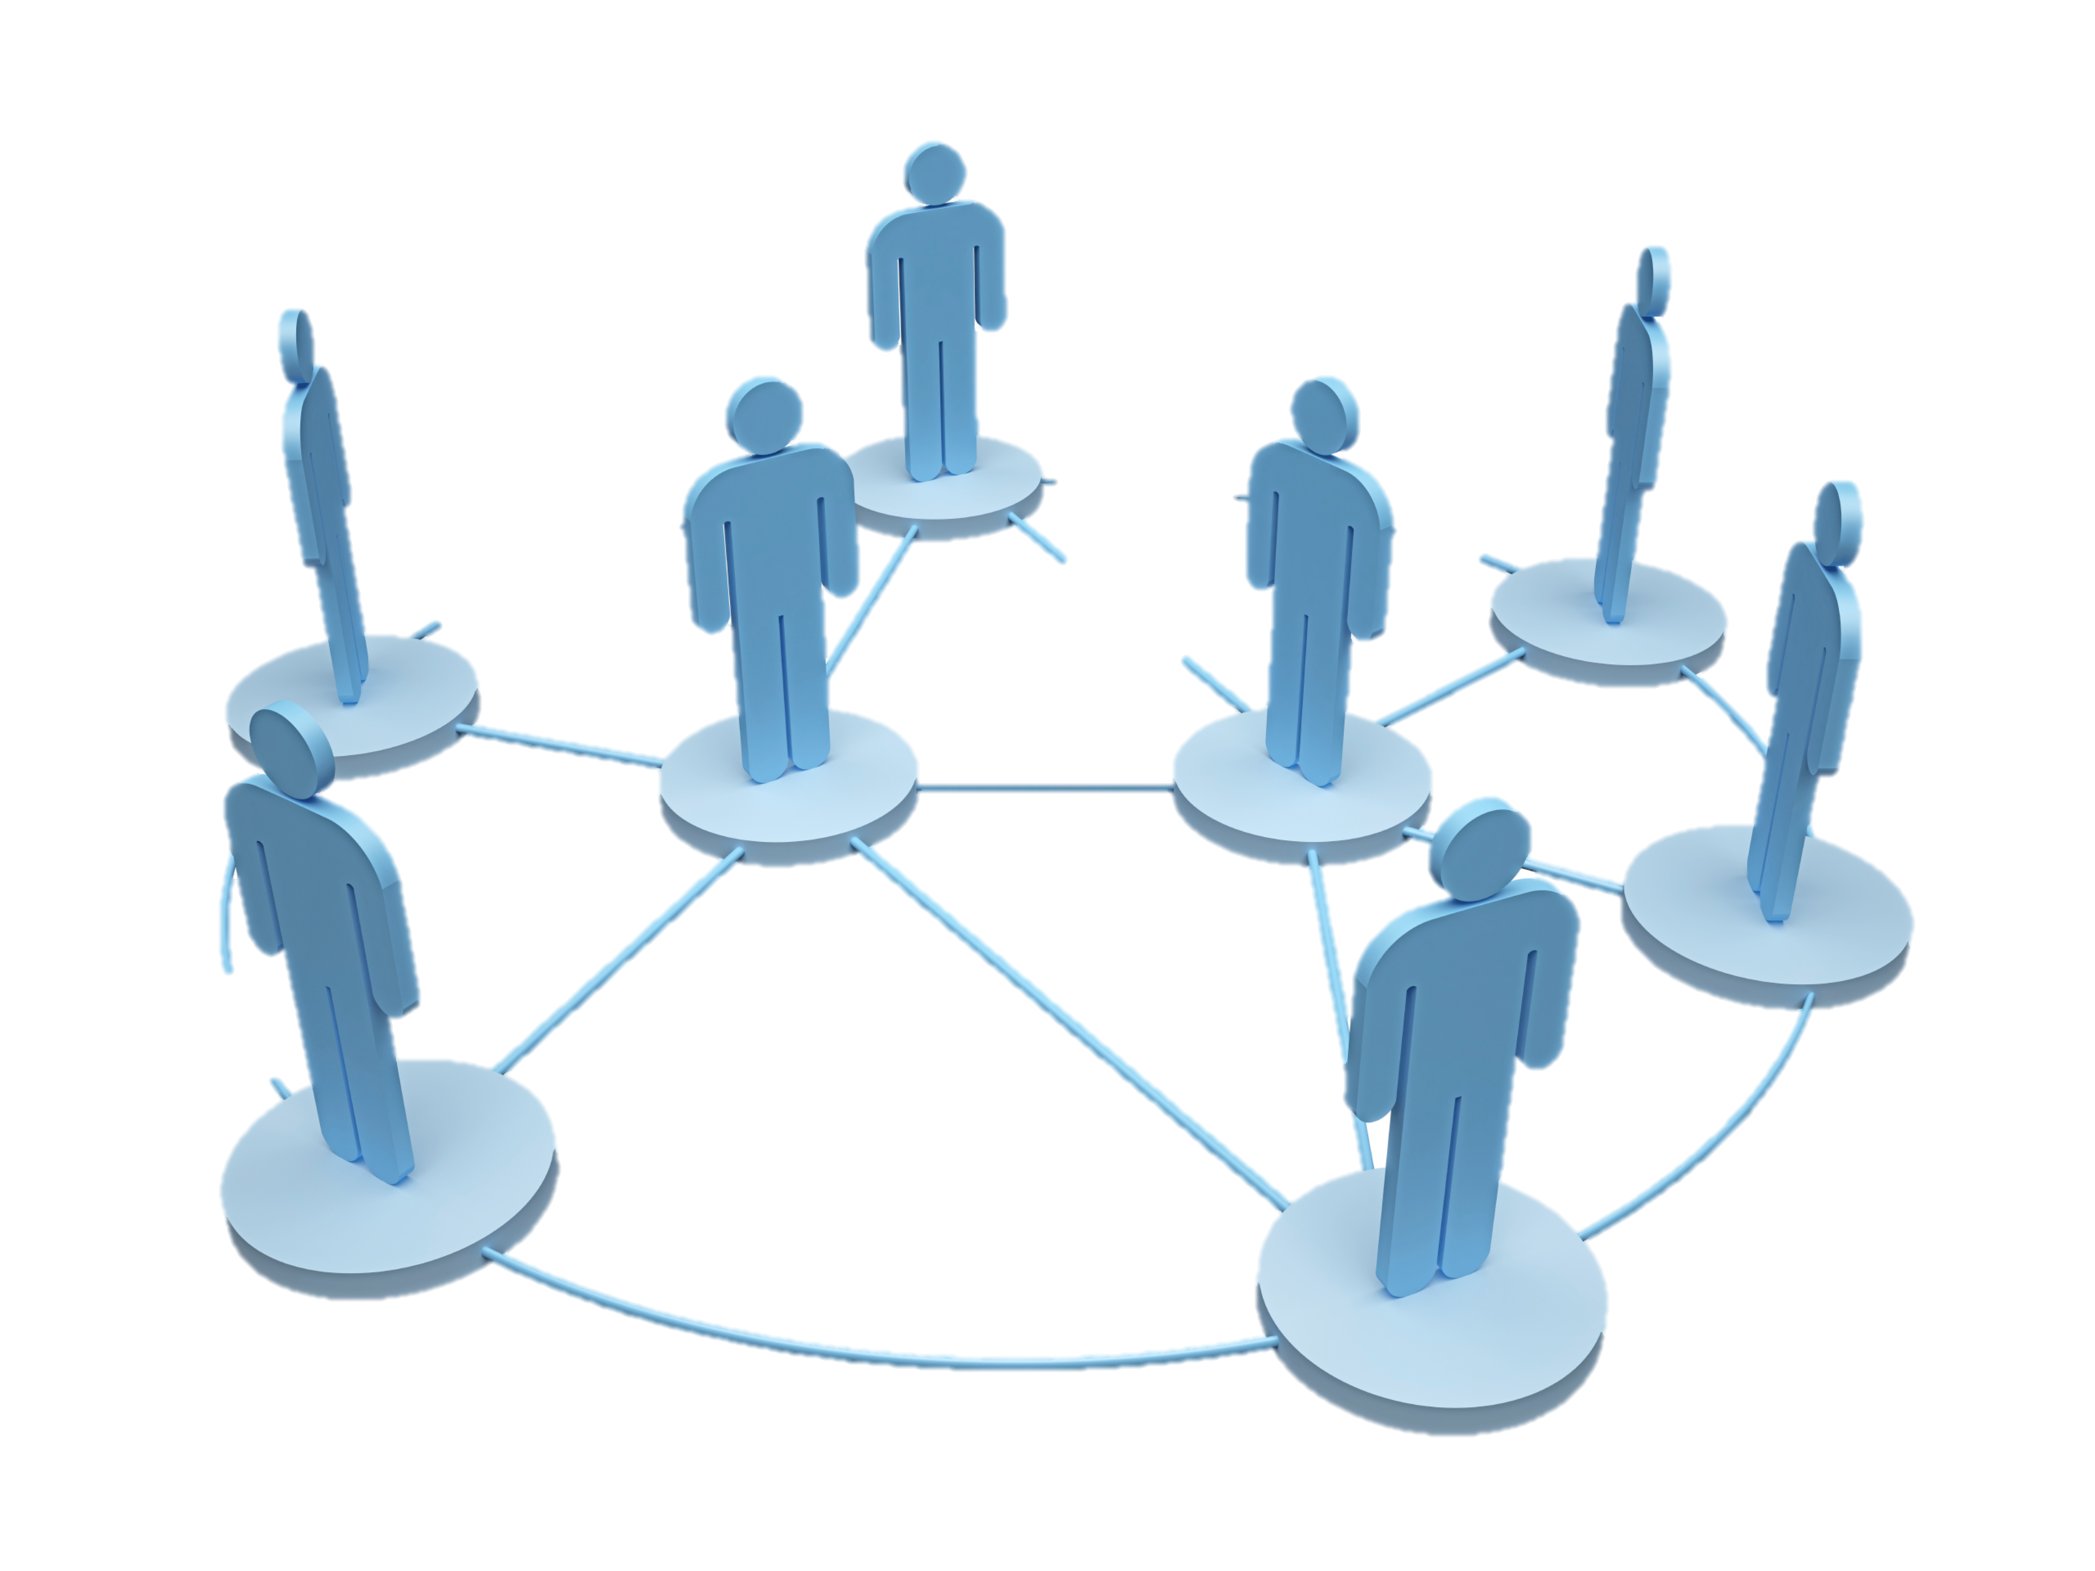
How ISIS uses Twitter https://www.kaggle.com/fifthtribe/how-isis-uses-twitter
Beverly Rice
Springboard Capstone 2
March 2018

Slide 2

Overview
Client & Problem Set
Description of Data Set
Data Wrangling Steps
Exploratory Analysis
Results of Analysis
Recommendations for Client
Suggestions for Improvement

Slide 3
Client & Problem Set
Fifth Tribe: Private-Sector company focused on open-source community content and developing counter-extremism messaging campaigns and tools
Board of the Global Community Engagement & Resilience Fund
Support local, community-level initiatives aimed at strengthening resilience against violent extremism
Problem: Identify influencers in the pro-ISIS twitter network and conduct sentiment analysis on which clergy pro-ISIS individuals support versus denounce/dislike. For this particular project, an ‘influencer’ is considered an active twitter user connected to 50 or more pro-ISIS individuals.

Slide 4
Data Set
Data Source: Fifth Tribe has scraped over 17,000 tweets from 100+ pro-ISIS Twitter subscribers from all over the world since the November 2015 Paris Attacks.
17,410 tweets in the data set
Name, twitter username, description, location, followers, number of statuses, and time, accompany each tweet
Name column is complete with no missing variables; some names are very similar to the username while others differ significantly; of note, some are written in Arabic
Username variable includes any combination of letters, numbers and underscores and is unique to every member
Description variable has missing values and when available, provides a brief synopsis of the individual tweet

Slide 5
Data Set (cont)
Location is also missing values
Followers variable lists solely the number of total followers the user has
Numberstatuses variable lists the total number of statuses/tweets published by the user
Time variable is the time the tweet was completed and published
Minimal cleaning was needed; missing values in the description and location variables were filled with ‘missing.’

Slide 6
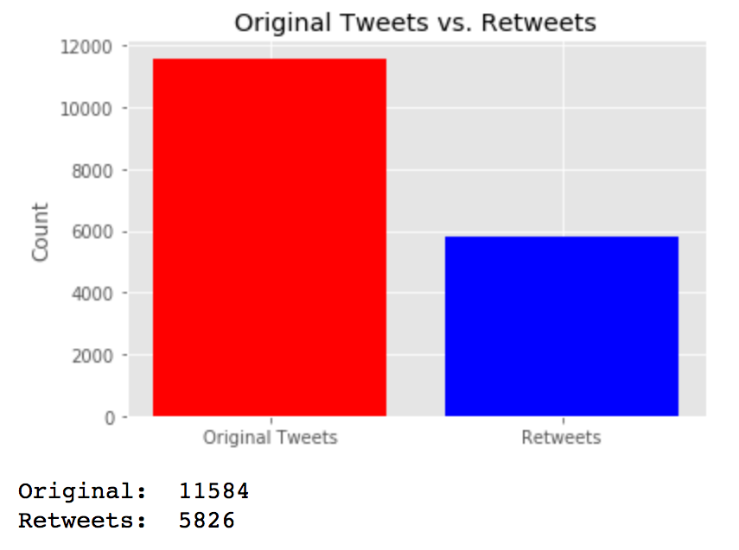
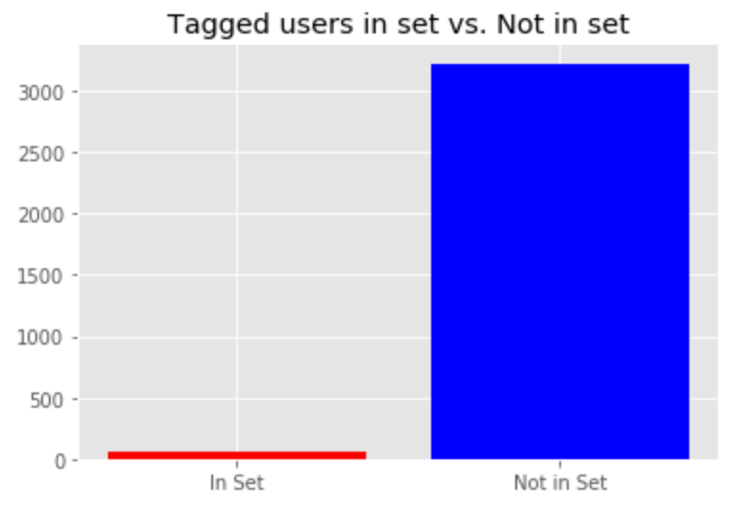
Data Wrangling
0. Conduct Exploratory Analysis
1. Investigate/fill null variables
2. Separate original tweets and retweets
3. ID users tagged to be included in network as nodes

Slide 7
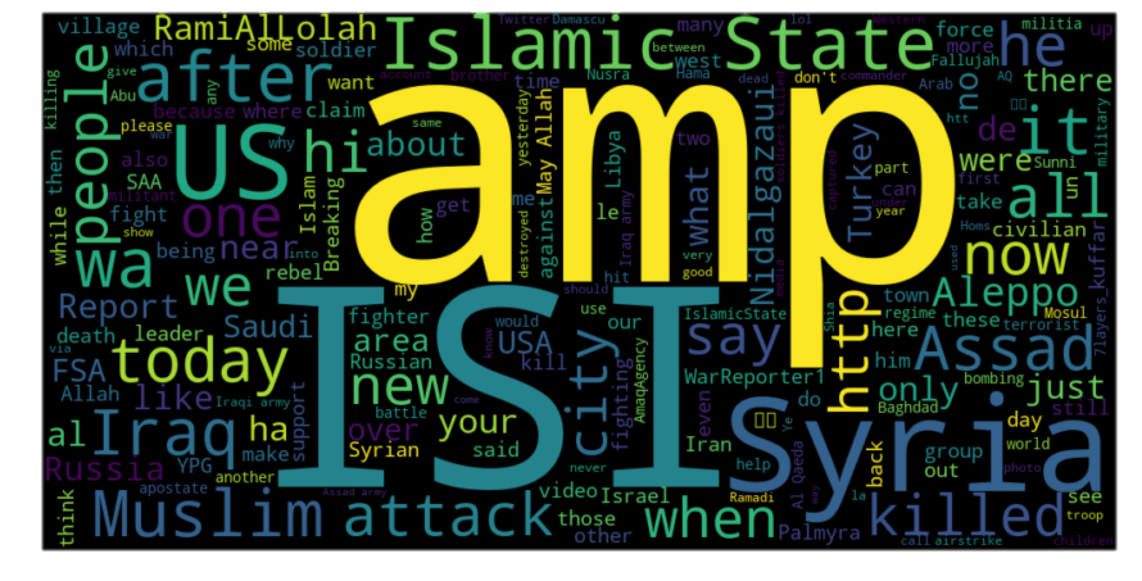
Exploratory Data Analysis

Slide 8
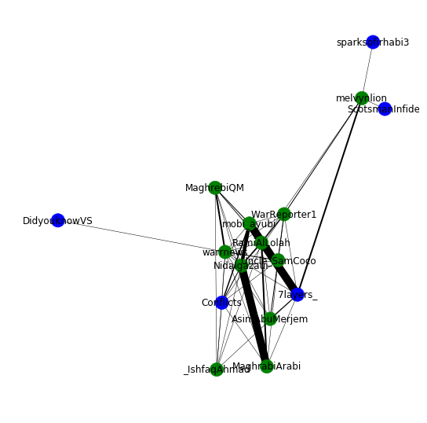
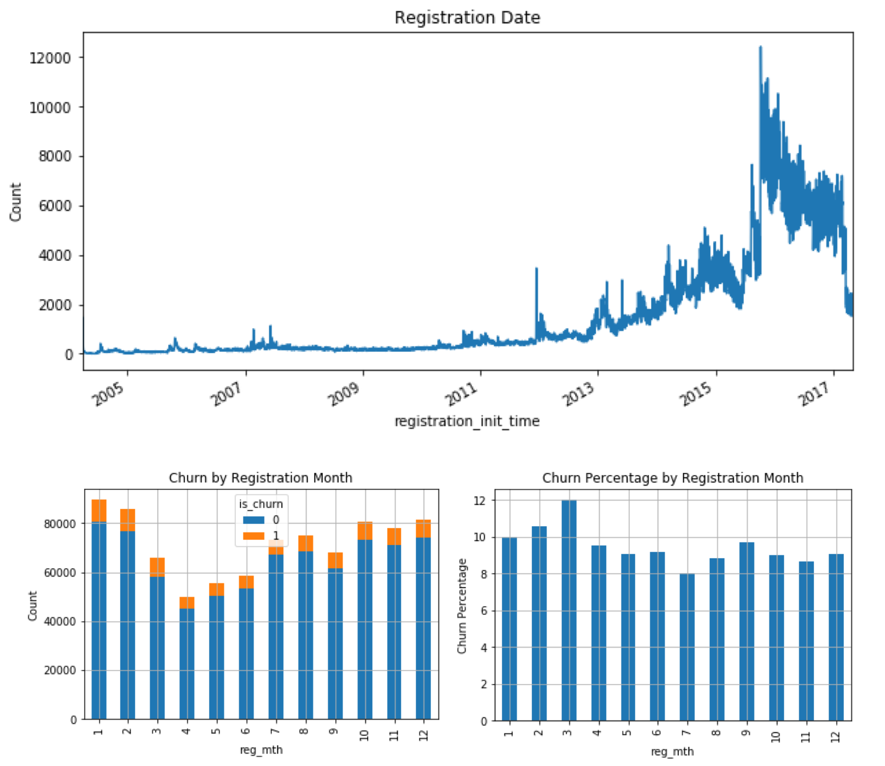
EDA (cont)
Top 10 Tweeters: [('Uncle_SamCoco', 1618), ('mobi_ayubi', 1078), ('WarReporter1', 713), ('warrnews', 666), ('RamiAlLolah', 655), ('melvynlion', 642), ('MaghrabiArabi', 454), ('_IshfaqAhmad', 432), ('AsimAbuMerjem', 289), ('NaseemAhmed50', 252)]
Top 10 Receivers(tagged): [('RamiAlLolah', 573), ('Nidalgazaui', 339), ('WarReporter1', 256), ('7layers_', 116), ('ScotsmanInfidel', 79), ('sparksofirhabi3', 76), ('Conflicts', 72), ('DidyouknowVS', 72), ('MaghrebiQM', 72), ('Uncle_SamCoco', 70)]

Slide 9
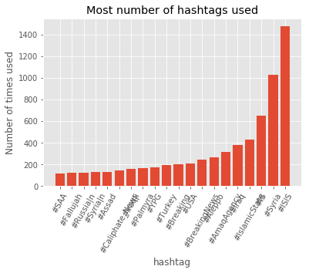
EDA (cont)

Slide 10
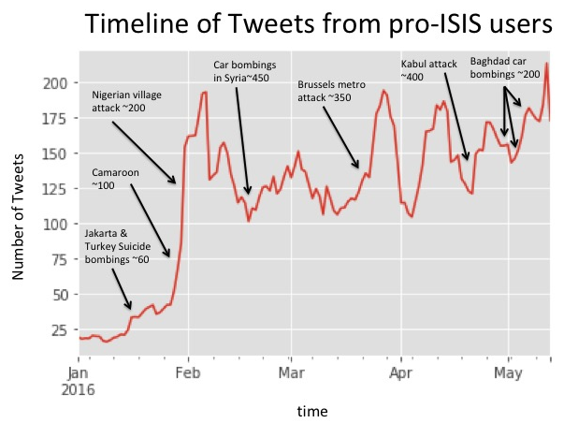
EDA (cont)

Slide 11
EDA (cont)
4 Parameters to define “Pro-ISIS” ranked by weight
1. Tagged #AmaqAgency – an ISIS affiliated news network (4x multiplier )
2. Tagged #ISIS, #IS, #IslamicState (3x multiplier)
3. Retweeted someone identified as pro-ISIS (2x multiplier)
4. Tweeted around the time of an ISIS terrorist attack (1x multiplier)
If a member exhibits/falls into a category, that single instance will be multiplied by the multiplier
All instances will be scored and added to determine whether an individual is pro-ISIS on a high, med or low scale
twitterUSER3 tagged AmaqAgency once, ISIS twice and retweeted a pro-ISIS user seven times. twitterUSER3's score would be: 4(1) + 3(2) + 2(7) + 1(0) = 24
4x #AmaqAgency 3x #ISIS 2x RT a pro-ISIS user 1x Tweeted around time of attack

Slide 12
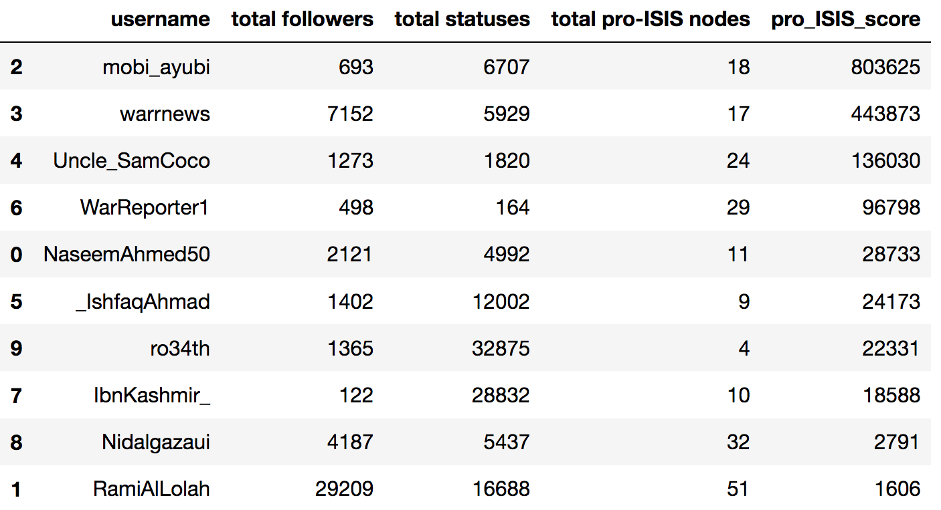
Most Influential Mbrs

Slide 13
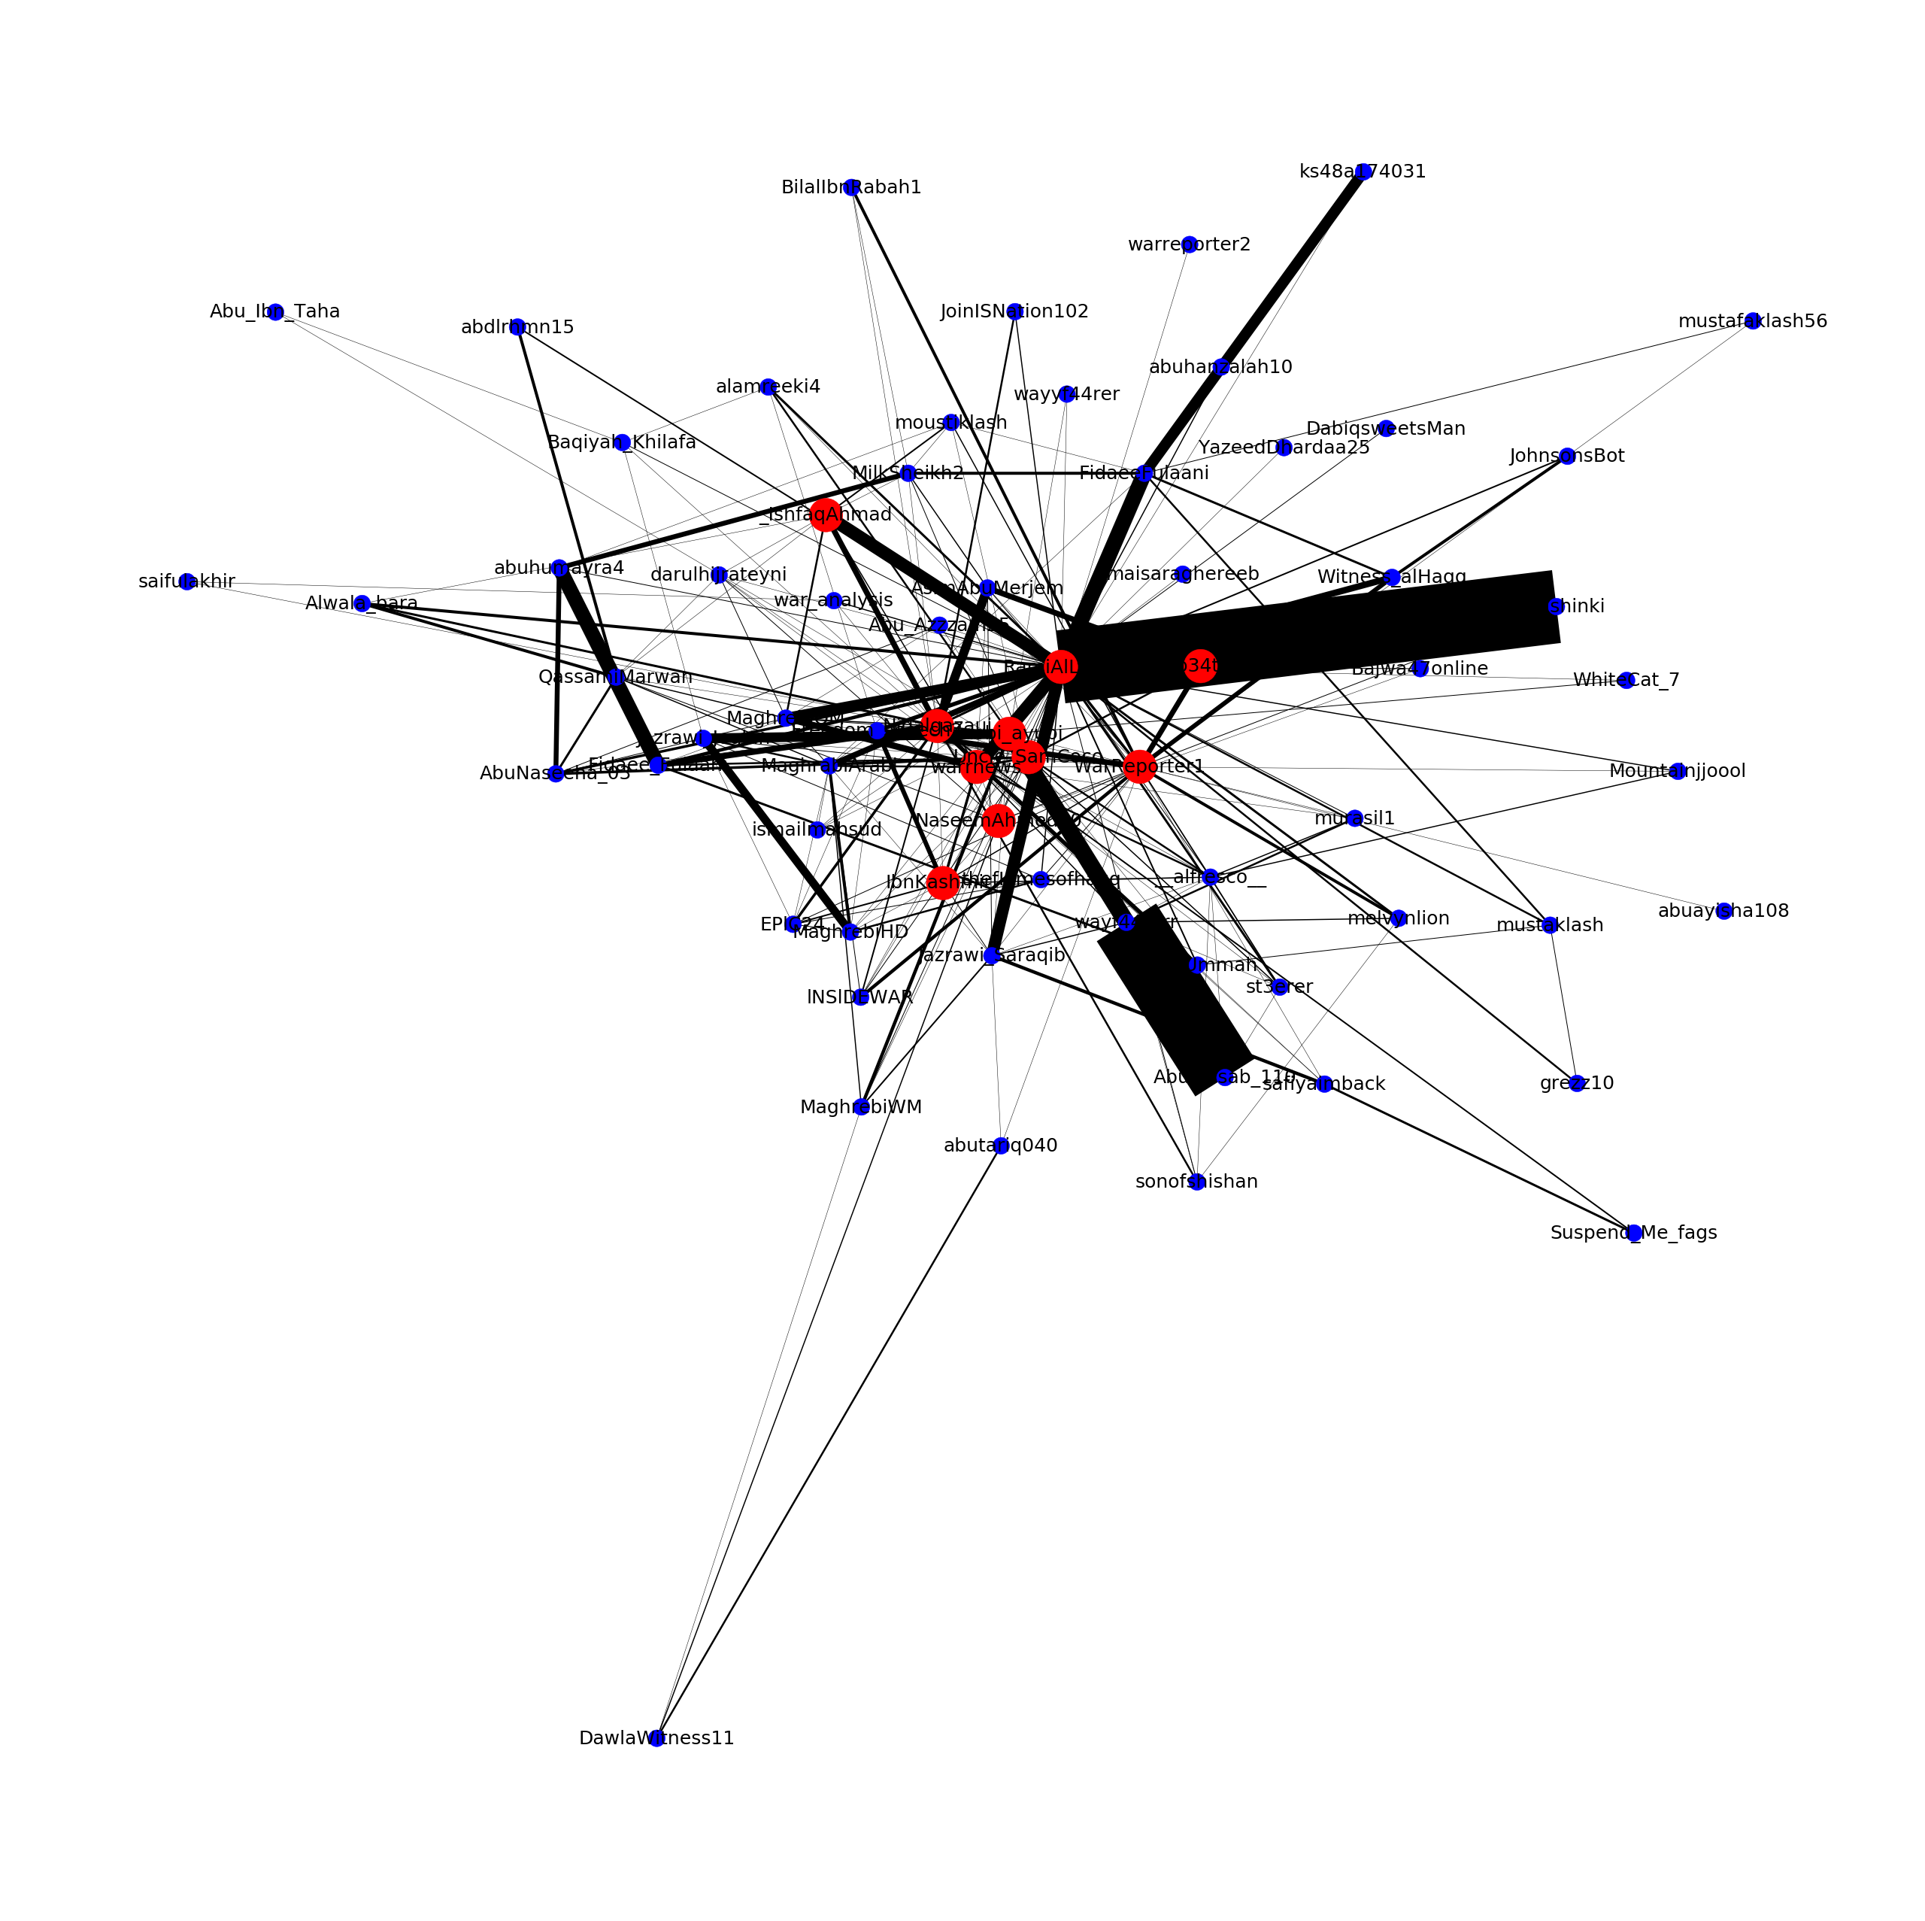

Slide 14
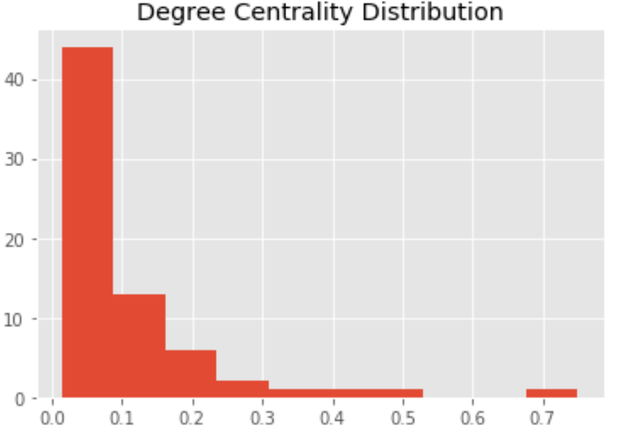
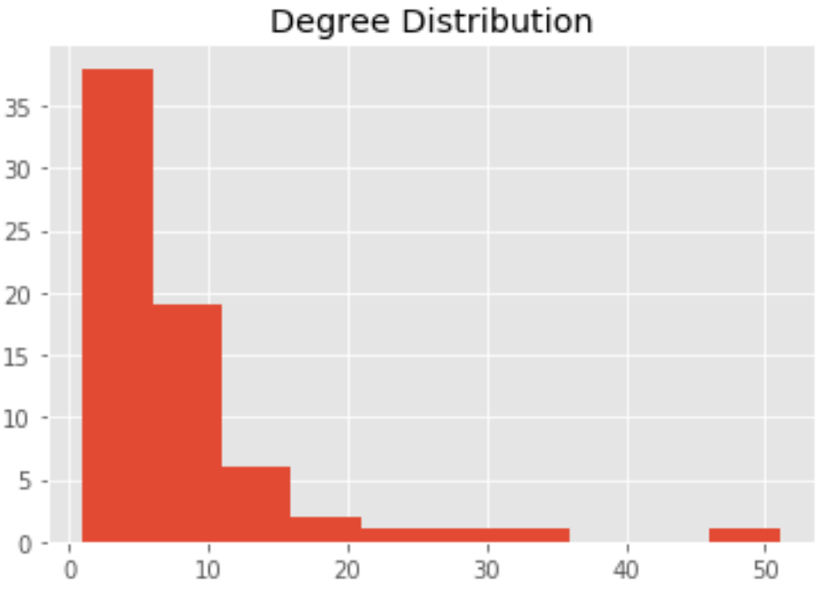
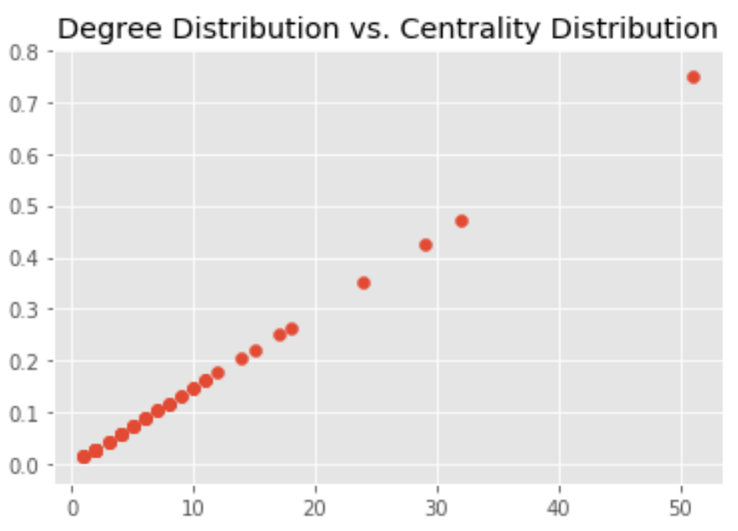
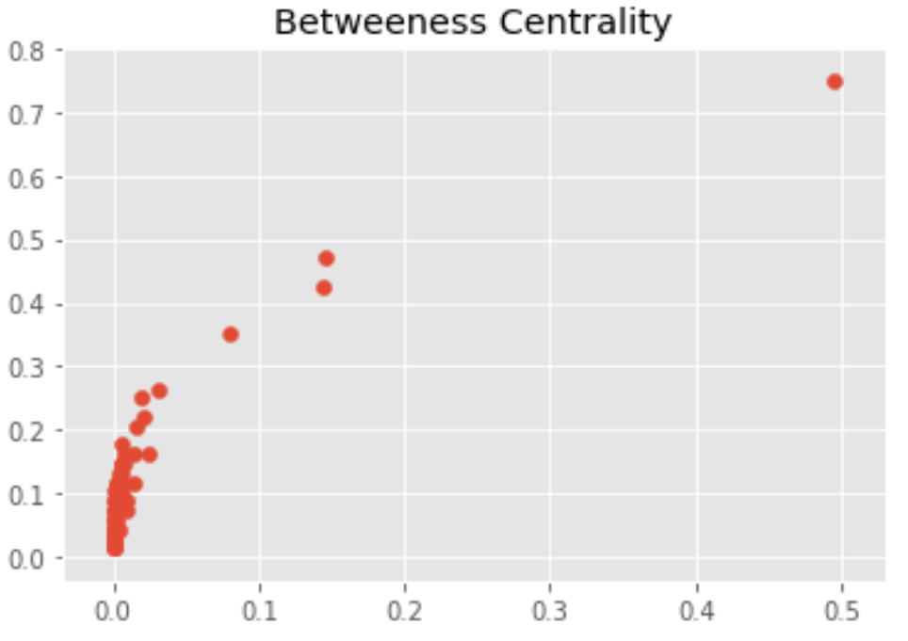
EDA (cont)

Slide 15
Results of Analysis
The most influential pro-ISIS twitter members were mobi_ayubi, warrnews, UncleSamCoCo, WarReporter1, NaseemAhmed50, _IshfaqAhmad, ro34th, IbnKashmir_, Nidalgazaui, RamiAlLolah
RamiAlLolah had the highest degree centrality and betweeness centrality of all the pro-ISIS users defined by the data set
The top 3 pairs of users were RamiAlLolah & Jazrawi_Joulan, Nidalgazaui & Jazrawi_Joulan, and Maghrabi & mobi_ayubi
There were a total of 140 cliques, the largest involving RamiAlLolah, Nidalgazaui, UncleSamCoco, WarReporter1, mobi_ayubi, NaseemAhmed50, and warrnews

Slide 16
Recommendations for KKBox
An additional data set that can be used in conjunction with this project is that provided by the ‘Tweets Targeting ISIS’ kaggle competition
The new set contains roughly 122,000 tweets collected on two separate days, which contained any of the following terms: ISIS, ISIL, DAESH, islamicstate, raqqa, mosul, and “Islamic state”
This data set would be a good backdrop against which to measure the pro-ISIS tweets
Another resource that may be of good use to this project is tweepy; theoretically tweepy could pull the friends of pro-ISIS members and provide more insight on any one individual’s network

Slide 17

Suggestions for Improvement
Acquire additional data sets to be used in conjunction with the one provided
Broaden definition of pro-ISIS and supplement data accordingly

Slide 18
Questions???

